Slide 1


ARTIFICIAL INTELLIGENCE WITHOUT BORDERS

Slide 2

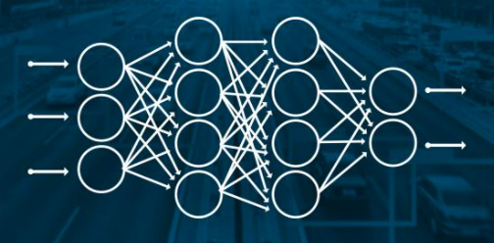
Introduction to Deep Learning
Deep learning is a type of machine learning and artificial intelligence (AI) that imitates the way humans gain certain types of knowledge. Deep learning is an important element of data science, which includes statistics and predictive modeling.
AILABS Property, All rights reserved

Slide 3
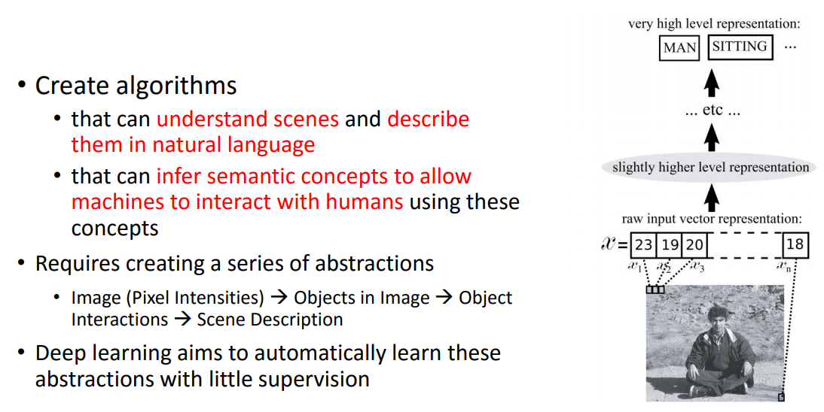
A Motivational Task: Percept's Concepts
AILABS Property, All rights reserved

Slide 4
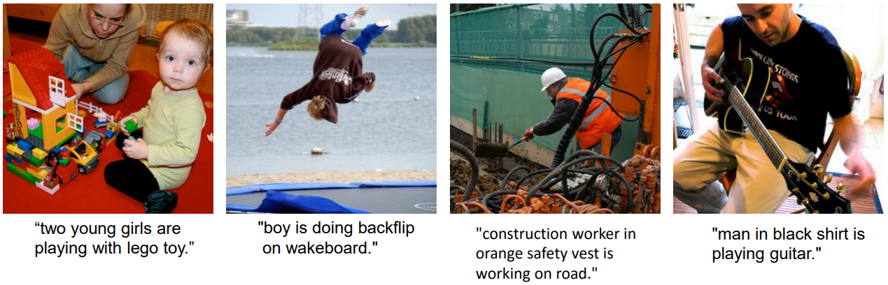
Deep Visual-Semantic Alignments for Generating Image Descriptions
AILABS Property, All rights reserved

Slide 5
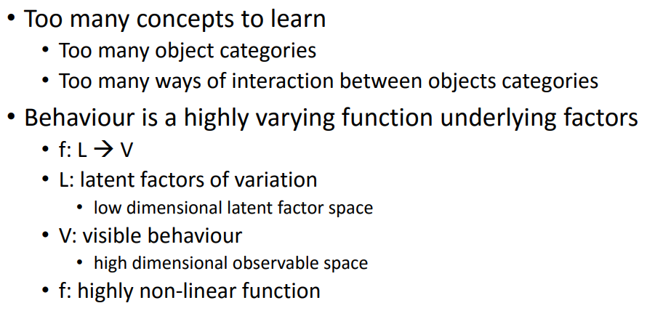
Challenge in Modelling Complex Behavior
AILABS Property, All rights reserved

Slide 6
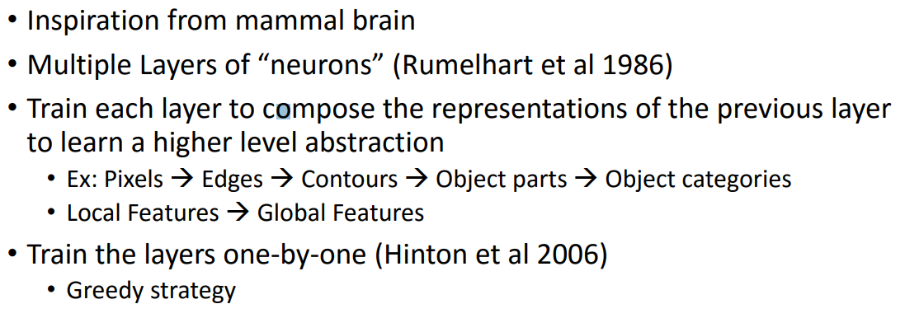
How do We Train Deep Architectures?
AILABS Property, All rights reserved

Slide 7
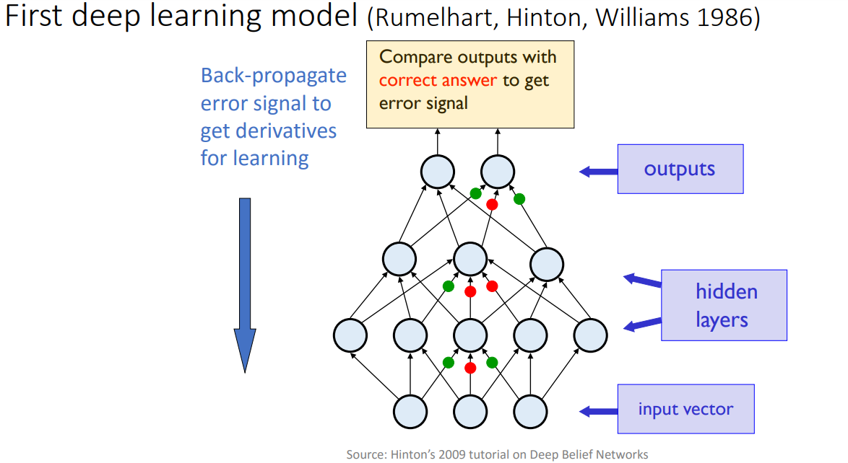
Multilayer Perceptron with Back-propagation
AILABS Property, All rights reserved

Slide 8
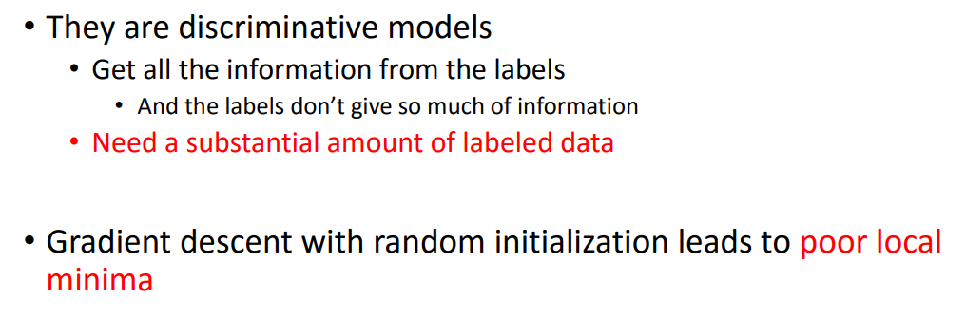
Drawbacks of Back-propagation based Deep Neural Networks
AILABS Property, All rights reserved

Slide 9
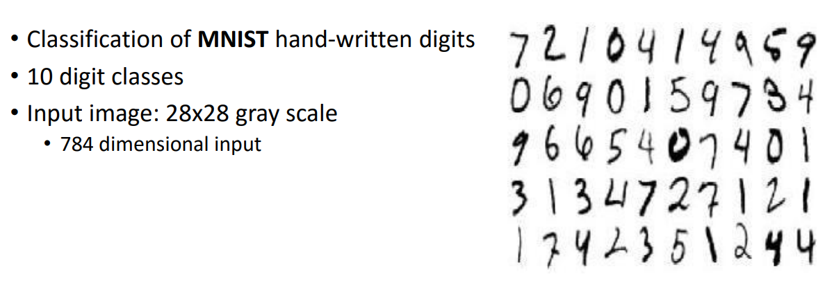
Hand-written digit recognition
AILABS Property, All rights reserved

Slide 10
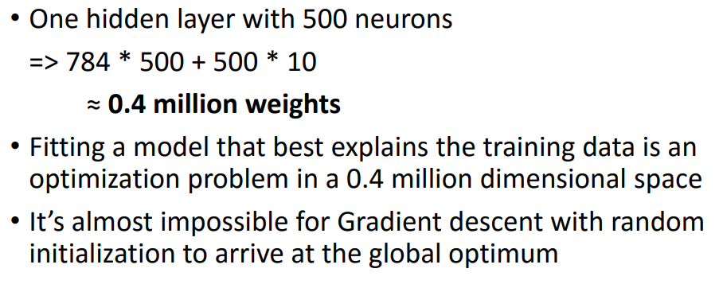
A Deeper Look at the Problem
AILABS Property, All rights reserved

Slide 11
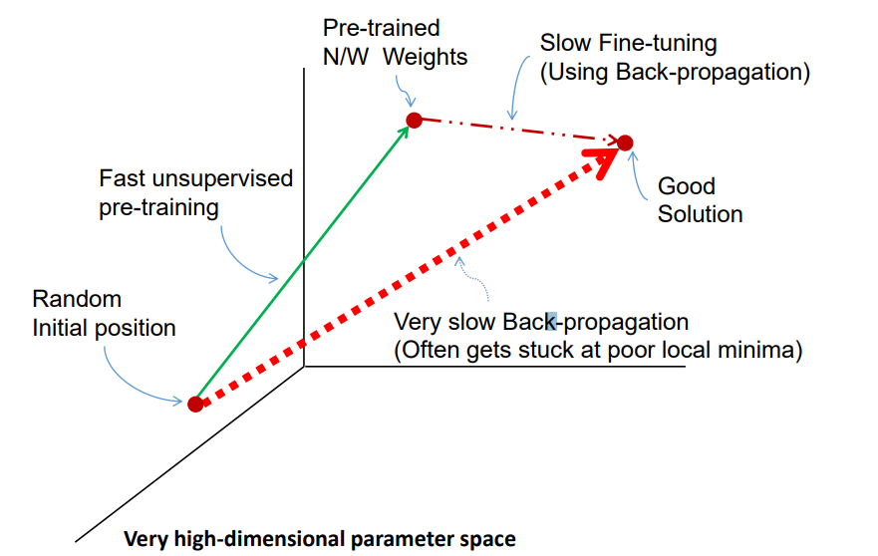
A Solution – Deep Belief Networks
AILABS Property, All rights reserved

Slide 12
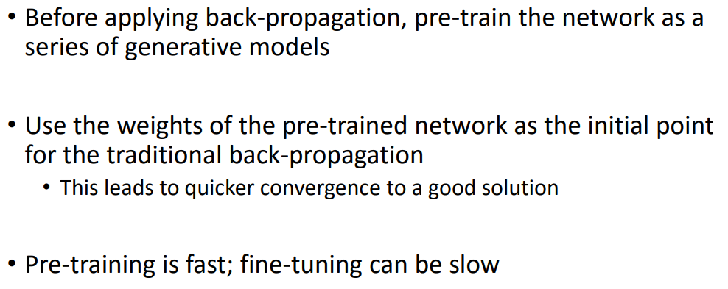
A Solution – Deep Belief Networks
AILABS Property, All rights reserved

Slide 13
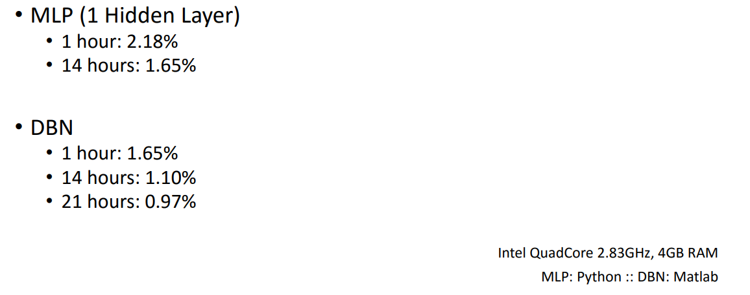
Quick Check: MLP vs DBN on MNIST
AILABS Property, All rights reserved

Slide 14
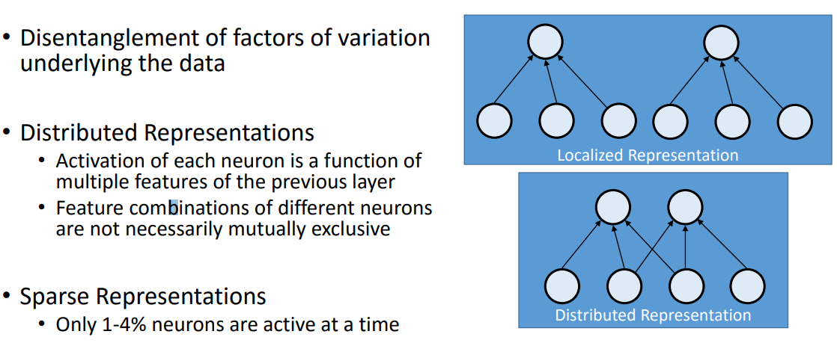
Intermediate Representations in Brain
AILABS Property, All rights reserved

Slide 15
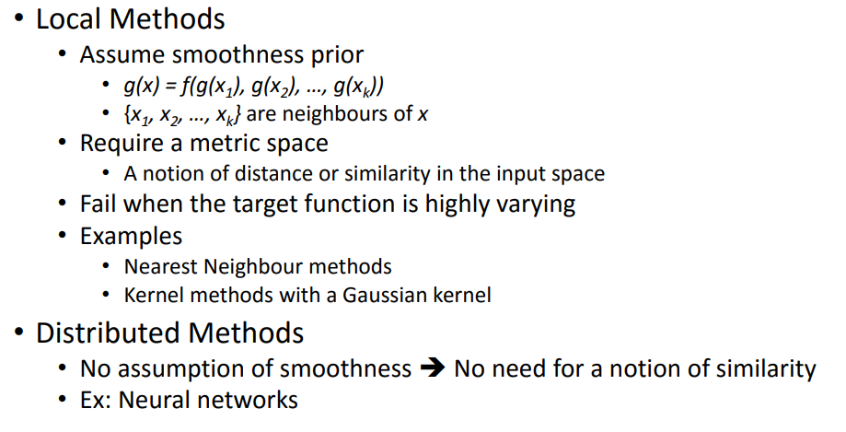
Local vs. Distributed in Input Space
AILABS Property, All rights reserved

Slide 16
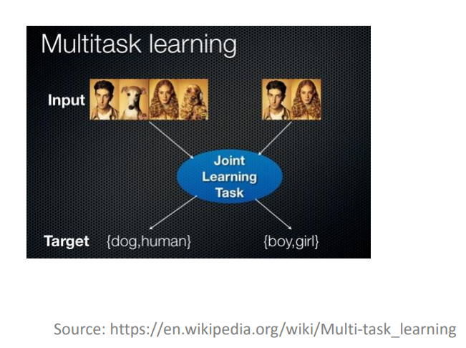
Multi-task Learning
AILABS Property, All rights reserved

Slide 17
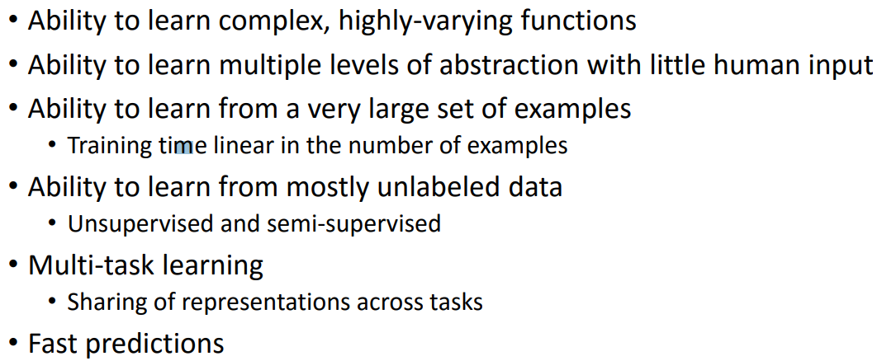
Desiderata for Learning AI
AILABS Property, All rights reserved

Slide 18
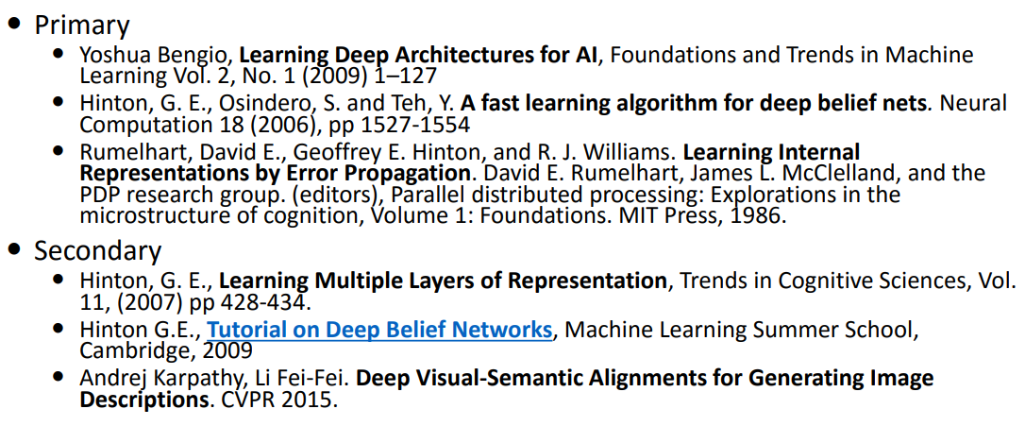
References
AILABS Property, All rights reserved

Slide 19

Thank You

